Slide 1

CNN Case Studies
Mahmoud Gamiel
Notes:
Everyone mint 150 hour videos uploaded on youtube

Slide 2
01
Fast Recap
The most important ideas to remember

Slide 3
We deal with every pixel as a feature
Why we need CNN ?
We have too many features
We need feature extractor tool
The prefect tool to make feature extraction is CNN

Slide 4
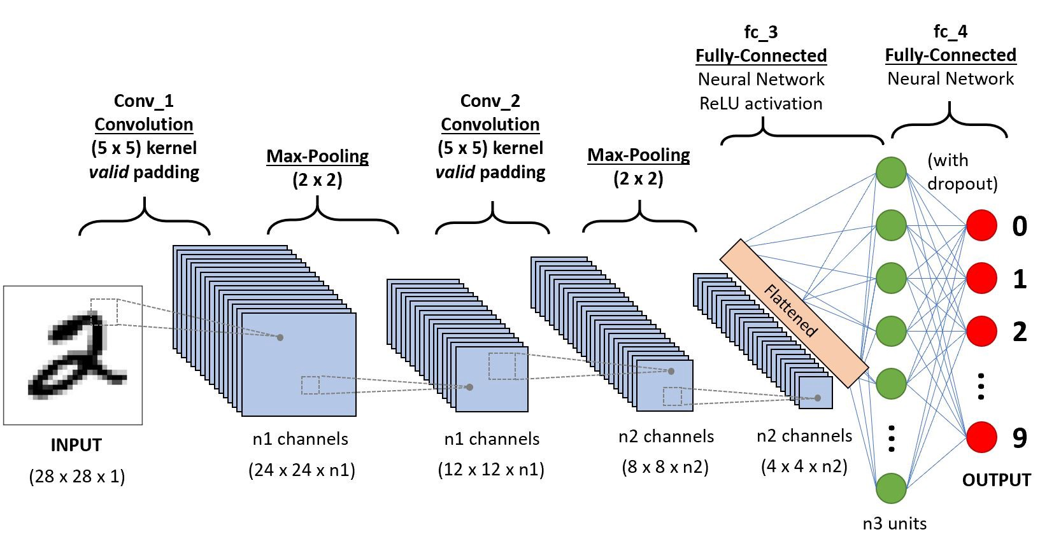
We go back again to fully connected layers
After making features extraction by CNN

Slide 5
Convolution process using filters
CNN Tools :

Slide 6
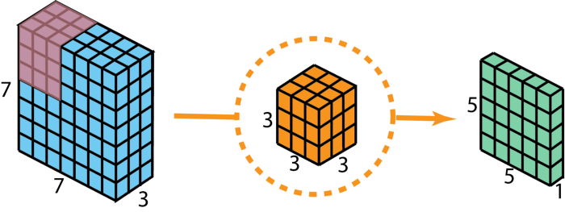
CNN Tools :

Slide 7
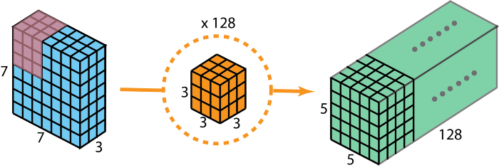
CNN Tools :

Slide 8
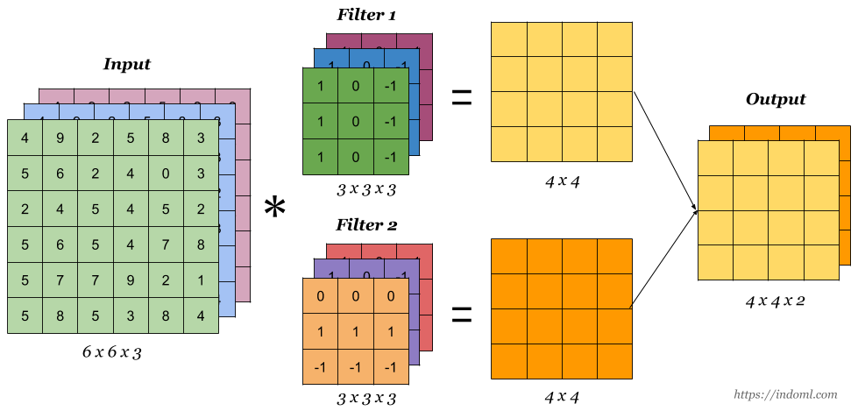
CNN Tools :

Slide 9
Padding
CNN Tools :

Slide 10
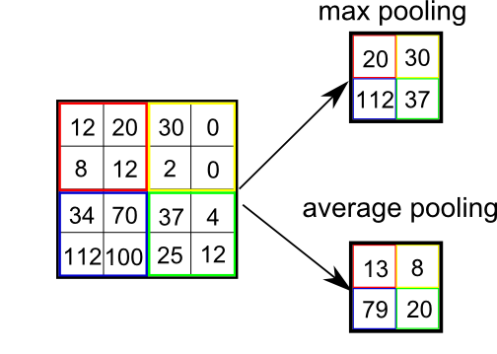
Pooling
CNN Tools :

Slide 11
02
Case Studies
How to combine letters to make a word

Slide 12
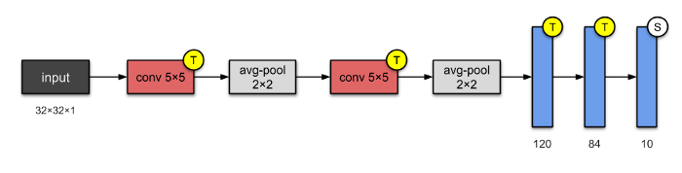
LeNet-5 (1998)
-LeNet-5 is one of the simplest architectures.
- It has 2 convolutional and 3 fully-connected layers.
- This architecture has about 60,000 parameters.

Slide 13
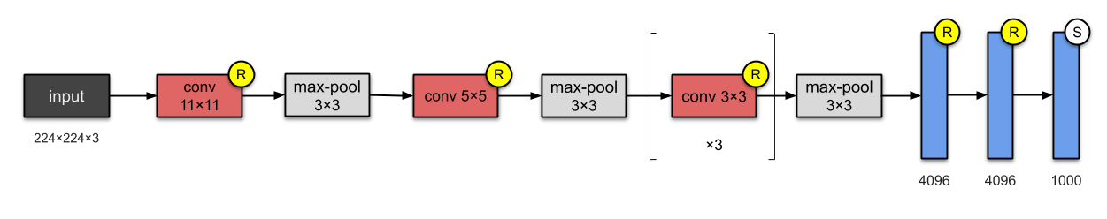
AlexNet (2012)
-AlexNet just stacked a few more layers onto LeNet-5
- AlexNet has 8 layers — 5 convolutional and 3 fully-connected.
-60M parameters
-They were the first to implement Rectified Linear Units (ReLUs) as activation functions.
-Dropout.

Slide 14
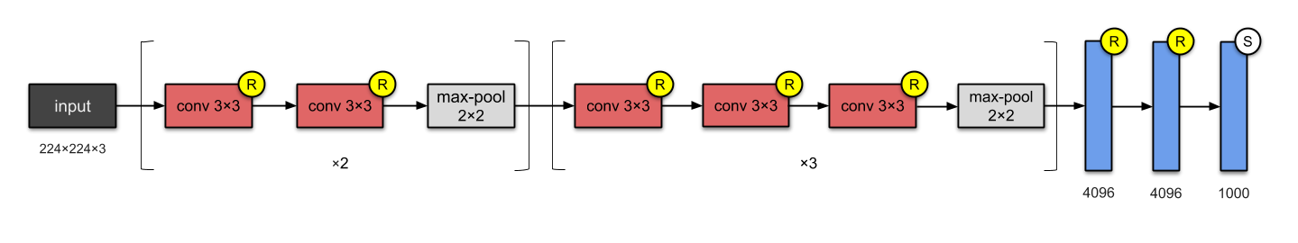
VGG-16 (2014)
-This network stacks more layers onto AlexNet and use smaller size filters (2×2 and 3×3).
- invented the VGG-16 which has 13 convolutional and 3 fully-connected layers.
-138M parameters
- carrying with them the ReLU tradition from AlexNet

Slide 15
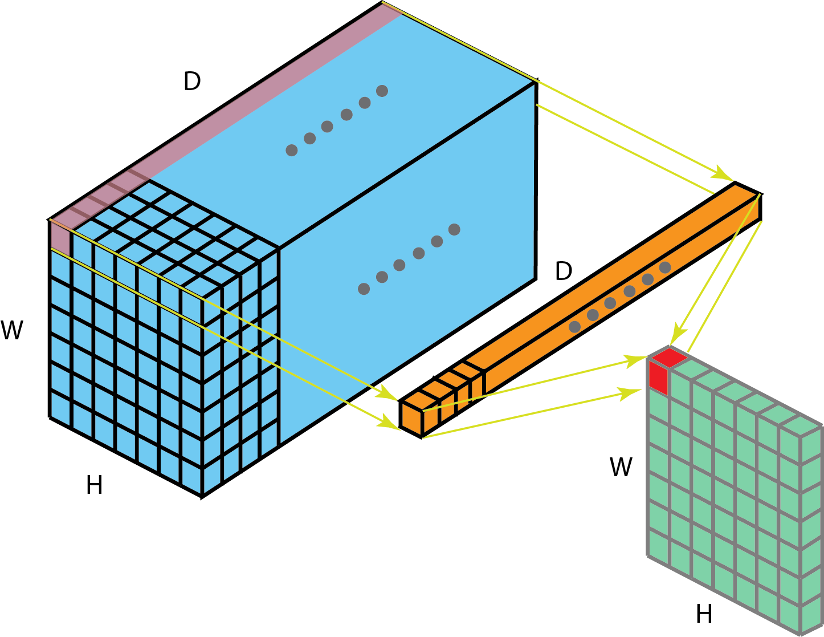
1 x 1 convolution (network in network)

Slide 16
Inception-v1 (2014)

Slide 17
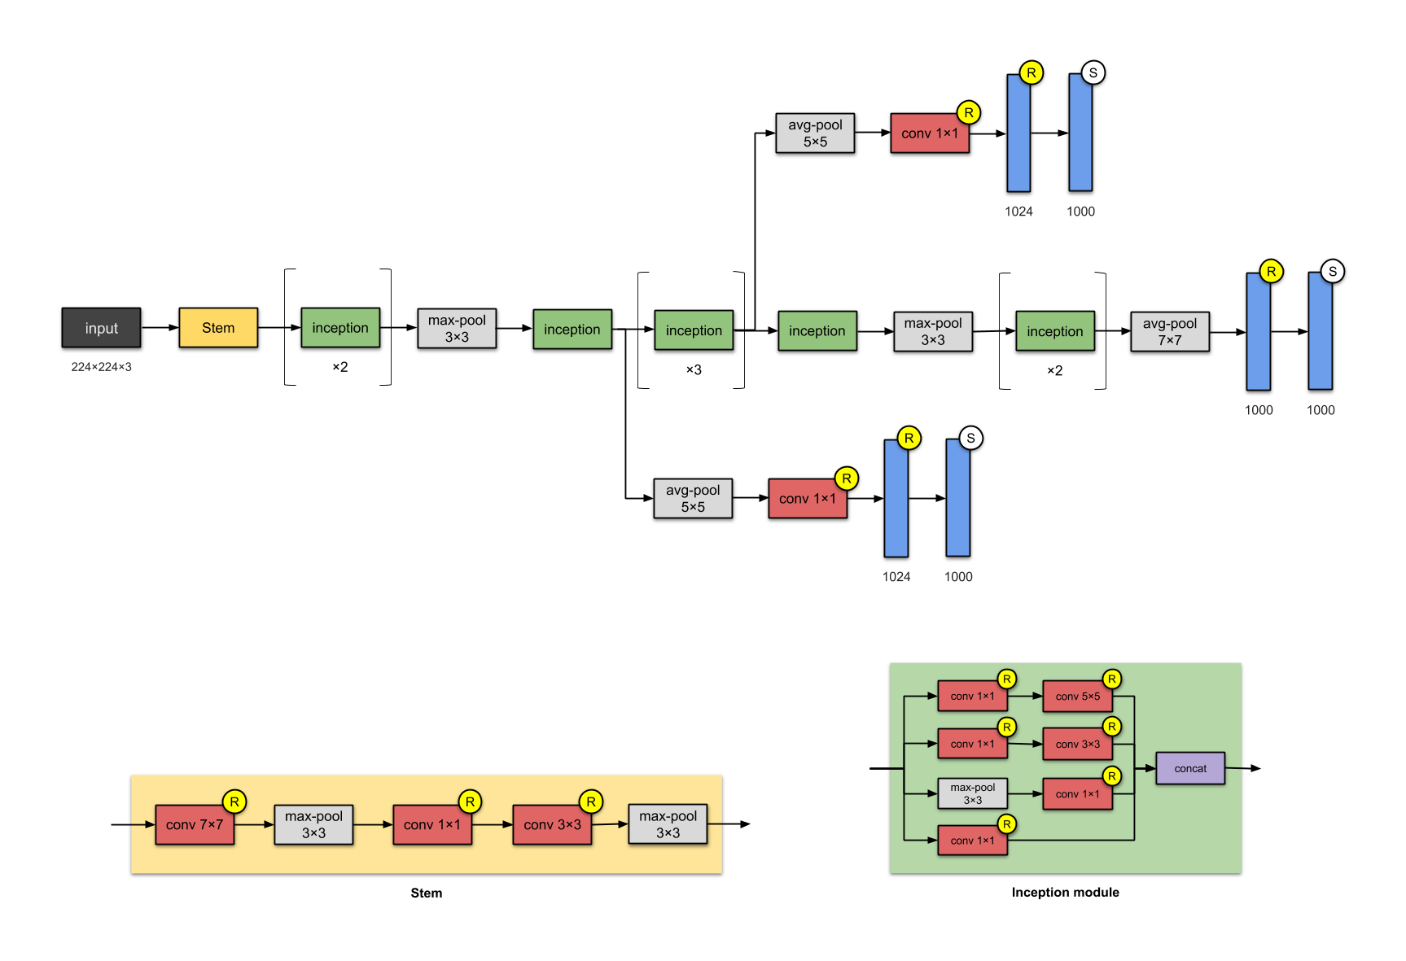

Slide 18
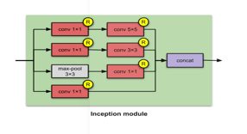

Slide 19
Inception-v1 (2014)
This 22-layer architecture with 5M parameters is called the Inception-v1.

Slide 20
Pattern to improve architectures

Slide 21
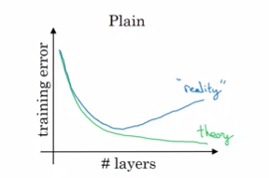
Increase number of layers

Slide 22
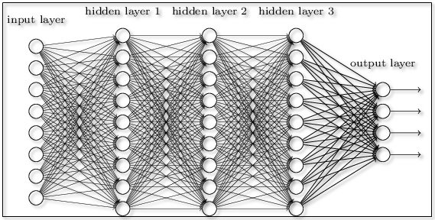
Vanishing and Exploding Gradient

Slide 24
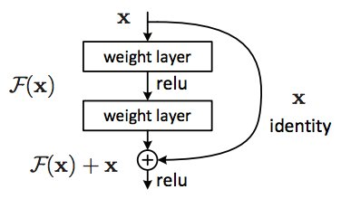
Residual Network (skip connection)

Slide 25
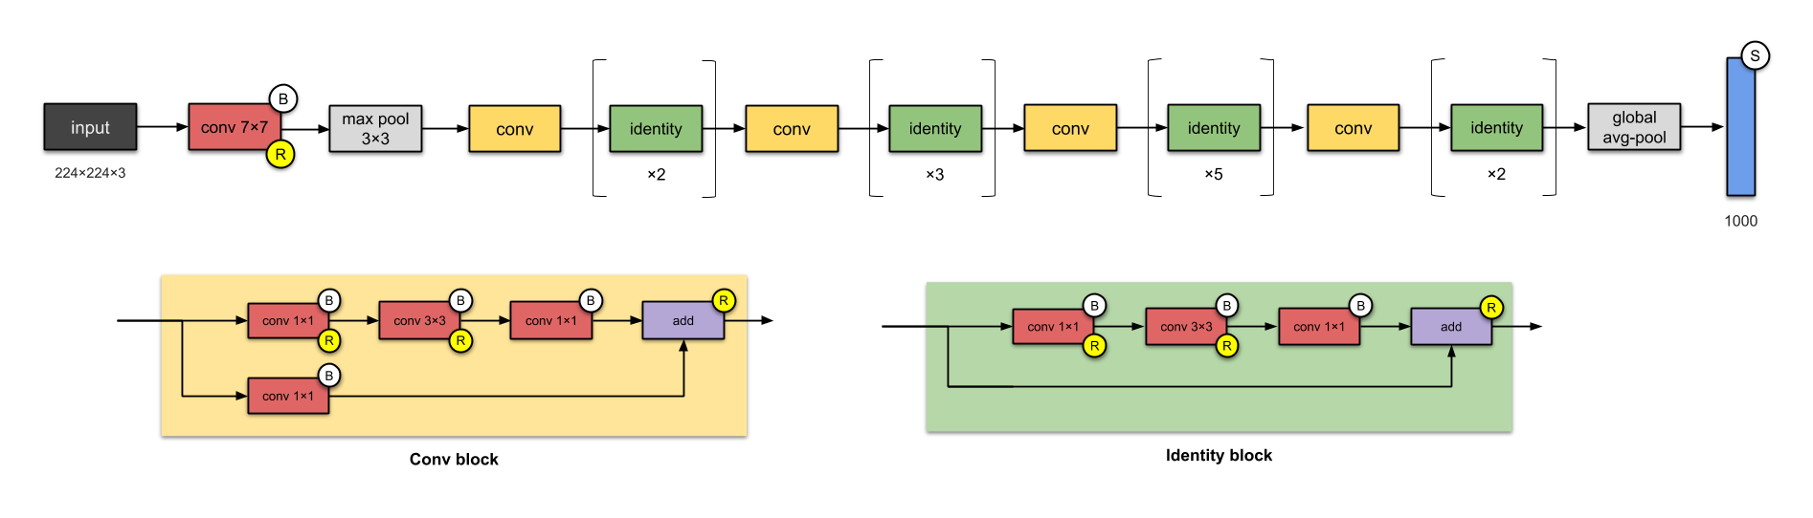

Slide 26
ResNet-50 (2015)
ResNet-50, with 26M parameters.

Slide 27
03
Transfer learning
Using case studies

Slide 28
Transfer learning

Slide 29
04
CODING
Practice time

